Slide 1
Credit Approval Models for Loan Products and *potential* Applications to Recommender Engines
ALL SUGGESTIOns WELCOME

Slide 2
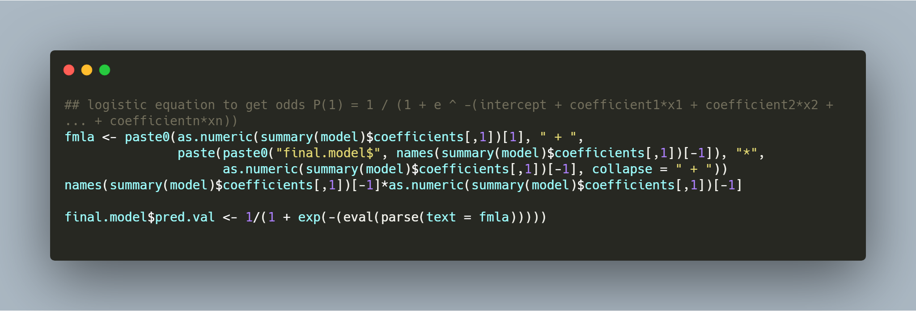
Introduction to …. Approval rate models
Approval rate models try to estimate the likelihood of being approved for a loan product. This is what we measure as the response rate in the overall population:
response.rate <- length(which(train$responded == 1))/nrow(train)
Depending on the rate in the population, we make determinations if we want to oversample or bootstrap.
We can get the point estimates or probabilities out of logistic regression models using a simple R function from the model output object.
An alternate option would be to parse the model object and then build the probabilities
logit2prob <- function(logit){ odds <- exp(logit) prob <- odds / (1 + odds) return(prob) }

Slide 3
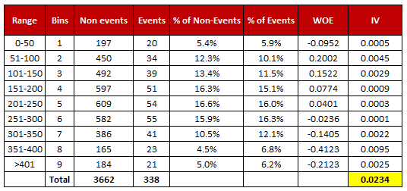
Feature Generation for Credit Approval Models
Historical tradeline data is aggregated at the user level to generate features across the credit profile categories listed below:
These variables are used to train the models. Weight of evidence and IV are frequently used and bucketed with binning algorithms to preserve monotonic trend and logical interpretability of the relationships.
The weight of evidence tells the predictive power of the independent variable in relation to the dependent variable. Added benefits include handling outliers in bins, missing values get their own bin, and woe variables handle categorical variables, so no need to create dummies. It is defined by ln(% events / % non-events)
The information value ranks variables on the basis of their importance and is defined as IV = ∑ (% of non-events - % of events) * WOE
R has several packages that compute both of these metrics. The information R package is one.
Class | Attribute Examples
GENERAL CREDIT PROFILE ATTRIBUTES | Number of Tradelines, Number of mortgages, Time Since Most Recent Trade Opened
INQUIRY TYPE ATTRIBUTES | Number of hard inquiries in the past 30,60 and 90 days
DELINQUENCY TYPE ATTRIBUTES | Number of times 30,60,90 days past due. Number of derogatory tradelines. Number of charged-off tradelines
PUBLIC RECORD ATTRIBUTES | Court Records. Bankruptcy Records on file.

Slide 4
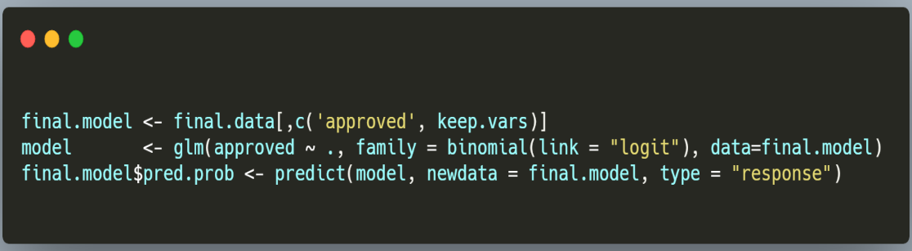
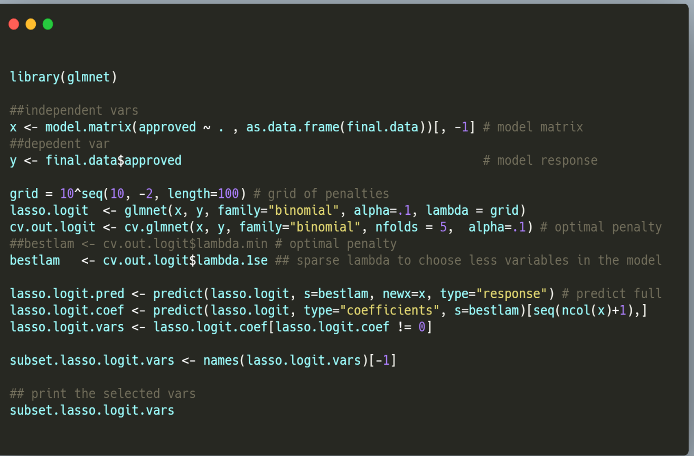
Building the Model Objects in R
We build the model using glm and a binomial classifier after all the variables have been transformed and appropriately binned. You can also use glmnet with LASSO for feature selection and regularization.

Slide 5
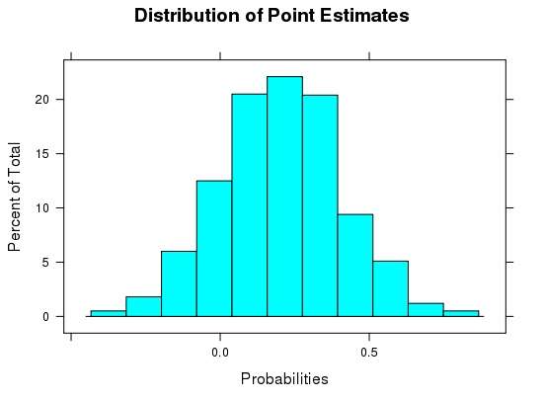
And the goal of building approval rate models IS …. to accurately provide estimates for the likelihood of approval
Yes, but how exactly should we measure that? Lots of answers in which I will go through some.
The probability estimates should have a distribution centered around the response rate in the population. As a quick sanity check, we can run a histogram on the point estimates:
Checking the distribution of the approved and rejects in each bin to see if the predicted approval rates line up with the actuals observed in the training set.
We can run models and set an objective function to minimize the error across bins to select the model that will yield the most accurate probabilities scoring each user for each product.
Predicted probability range | % of population | Actual Approval Rate | Predicted Approval Rate | Mean Error
[0 - .1 ) | 5.20% | 4.80% | 5.80% | 1.00%
[.1 - .2) | 12.00% | 12% | 15% | 3.00%
[.2 - .3) | 23.50% | 22% | 23.40% | 1.40%
[.3 - .4) | 18% | 32% | 38% | 6.00%
[.4 - .5) | 13.00% | 45% | 46.40% | 1.40%
[.5 - .6) | 10.00% | 57% | 52% | 5.00%
[.6 - .7) | 6% | 63% | 66% | 3.00%
[.7 - .8) | 5% | 72% | 75% | 3.00%
[.8 - .9) | 4% | 81% | 84% | 3.00%
[.9 – 1) | 3.30% | 93% | 95% | 2.00%

Slide 6
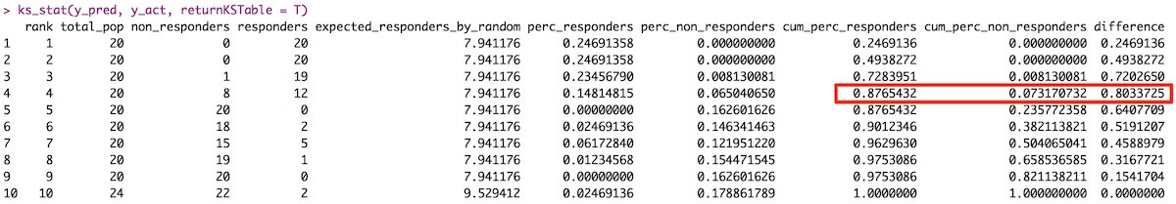
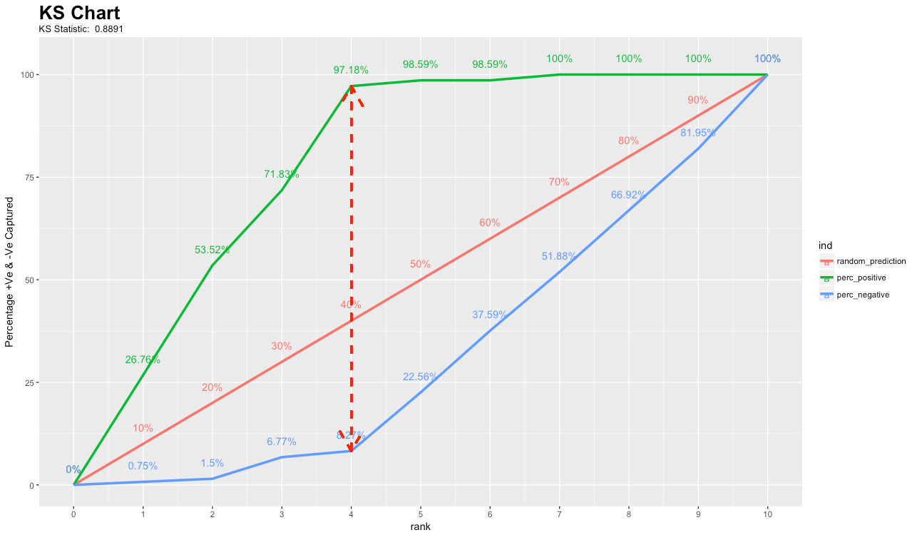
Measures for Model Evaluation
“All models are wrong, but some are …. Useful”
AIC – Akaike Information Criterion is a good comparative metric for evaluating models over the same dataset. It is a compromise between the sparsity of parameters and the maximum likelihood for estimation of the parameters. AIC= 2𝑘 − 2ln(𝑀𝑎𝑥 𝐿) where k is the number of estimates and L is the maximum likelihood function. The lower the value the better.
K-S Statistic is a diagnostic that measures how well the model can distinguish between responders and non-responders. Mathematically, KS is the max difference of the empirical distributions F1 and F2 of the respondents and non-respondents. Normally n = 10 is selected for a decile report, but other more granular bins can be selected. The KS will vary with the number of bins, so that should be controlled a priori.
ks_stat and ks_plot is available in the InformationValue package. You can use ks_plot to produce the lift chart.

Slide 7
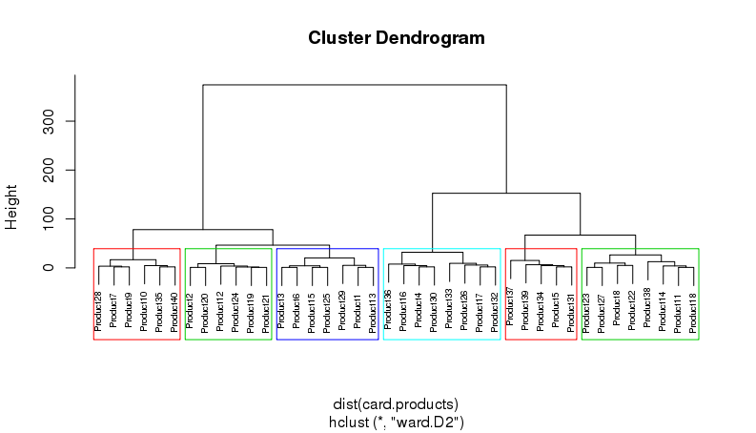
Hierarchical Clustering for Loan Products
Often times we have a considerable amount of products that we would like to group together to avoid building hundreds of models. Hierarchical Clustering can be used to classify these products into similar types so that we can build models on a group of cards and use that group model to score them in production.
Important dimensions to include in your clustering analysis are loan term variables, reward benefits, and customer profile dimensions like average FICO or Vantage score of the customer base.
You can use hclust function in the stats package to create the dendogram, etc. The ward.d2 method can be used to find the pruning height to produce any number of cluster groups you would like to obtain.
Snippet:
hc6 <- hclust(dist(card.products), method = "ward.D2" )
# Cut tree into 6 groups
sub_grp <- cutree(hc6, k = 6)
plot(hc6, cex = 0.6, labels = product.names)
rect.hclust(hc6, k = 6, border = 2:5)

Slide 8
Using Approval Rate Models in Recommender Engines
Collecting approval rate decisions across a suite of products including credit cards, personal loans and mortgages allows us to build models for each card product, and then rank the likelihood that they would be approved for that particular item.
As well as approval rate models, you can run projected revenue models to be used in tandem for ranking the products that are featured for any given individual.
If you want to maintain a certain level of approval rate on an applicant pool, you can run a constrained optimization technique to maximize revenue holding a minimum approval rate threshold. Most card issuers want to have a quality pool of applicants recommended to them.
Collaborative Filtering can be used on new users whom we have sparse profile information, and matched against similar users to recommend cards that would match their interests.

